Slide 1
Group 1 Network
Alex Lorenzo, Ryon Riley, Ian Vigrass, Brian Batinchok, Jesse Lambert, Edgar Castellanos

Slide 2
Outline
Ethernet
Serial cables
Switches
Routers
Servers
VLANS
Network Toplogy
Our Topology
Sources

Slide 3
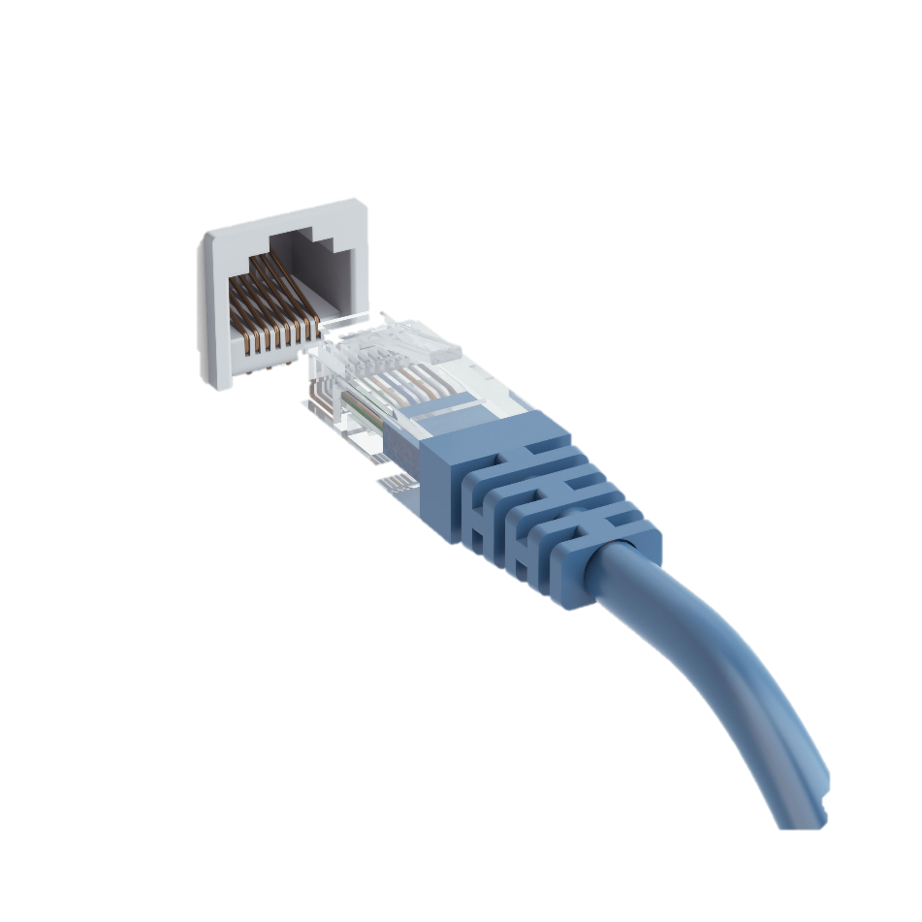
Ethernet
Uses twisted pair and fiber optic links
Created in 1980 and standardized in 1983
Transmits data in pieces called frames

Slide 4
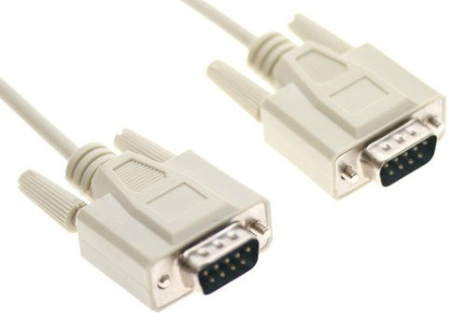
Serial Cables
A cable used to transfer information between two devices using the serial protocol
In our topology, used to connect two routers together so they can communicate
Example of a RS232 serial cable

Slide 5
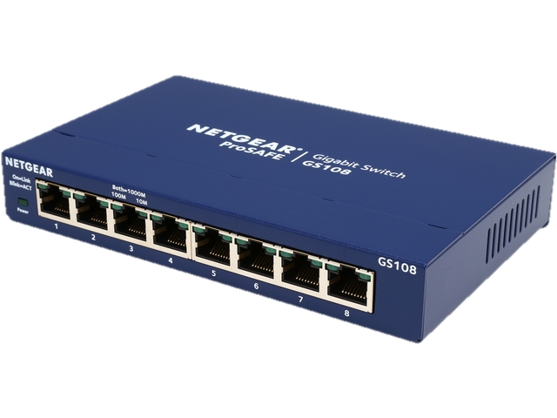
Switches
Connects devices together on a network
Uses packet switching
Each device’s MAC address is stored
Delivers traffic only to correct device

Slide 6
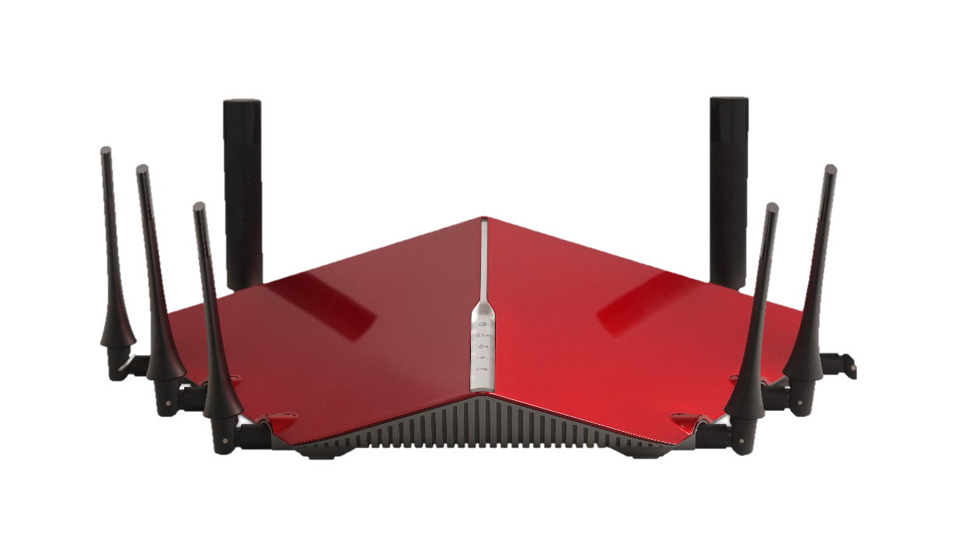
Routers
Perform traffic directing functions on the internet
Uses a routing table to decide where packets go

Slide 7
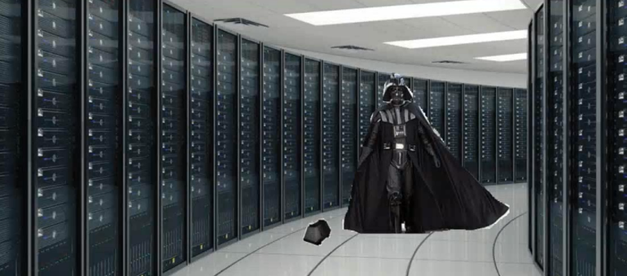
Servers
Provides functionality, information, and resources for devices
Uses client-server model
Client sends request to server
Server performs action and sends response

Slide 8
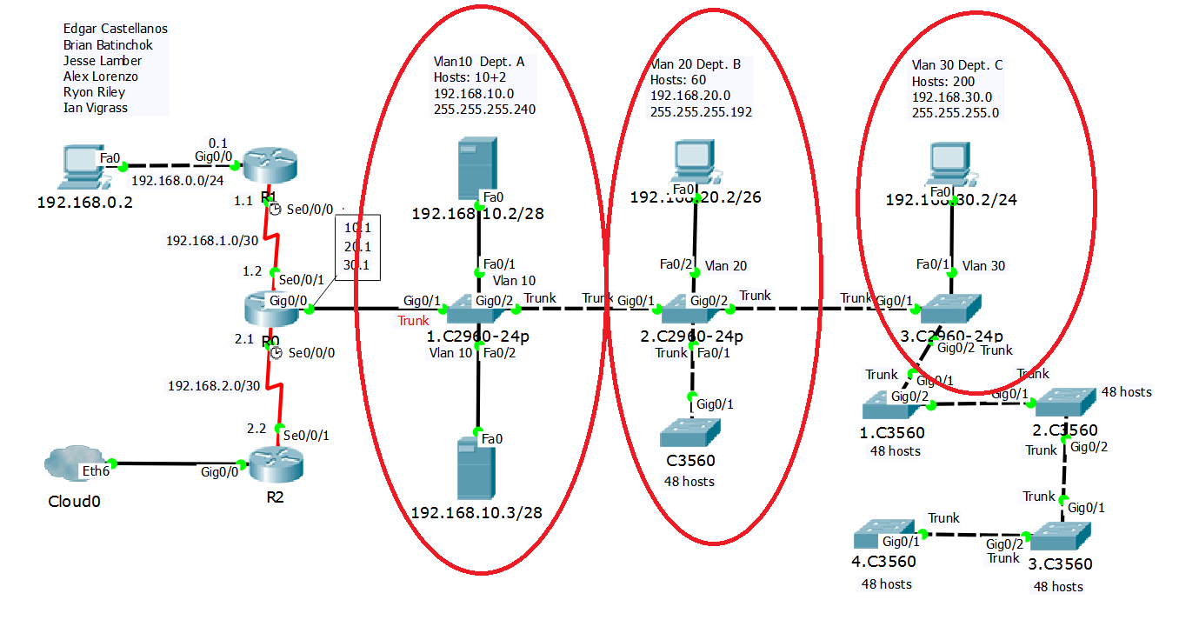
VLANS
A virtual lan – any broadcast domain that is partitioned and isolated in a computer network
Typically comprised of one or more Ethernet swithces
VLANS implemented in our topology

Slide 9
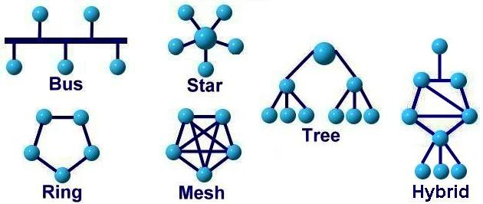
Network Topology
Arrangement of various elements of a computer network
Devices are graphically mapped into a geometric shape
Mapping the data flow between components determine the logical topology of the network

Slide 10
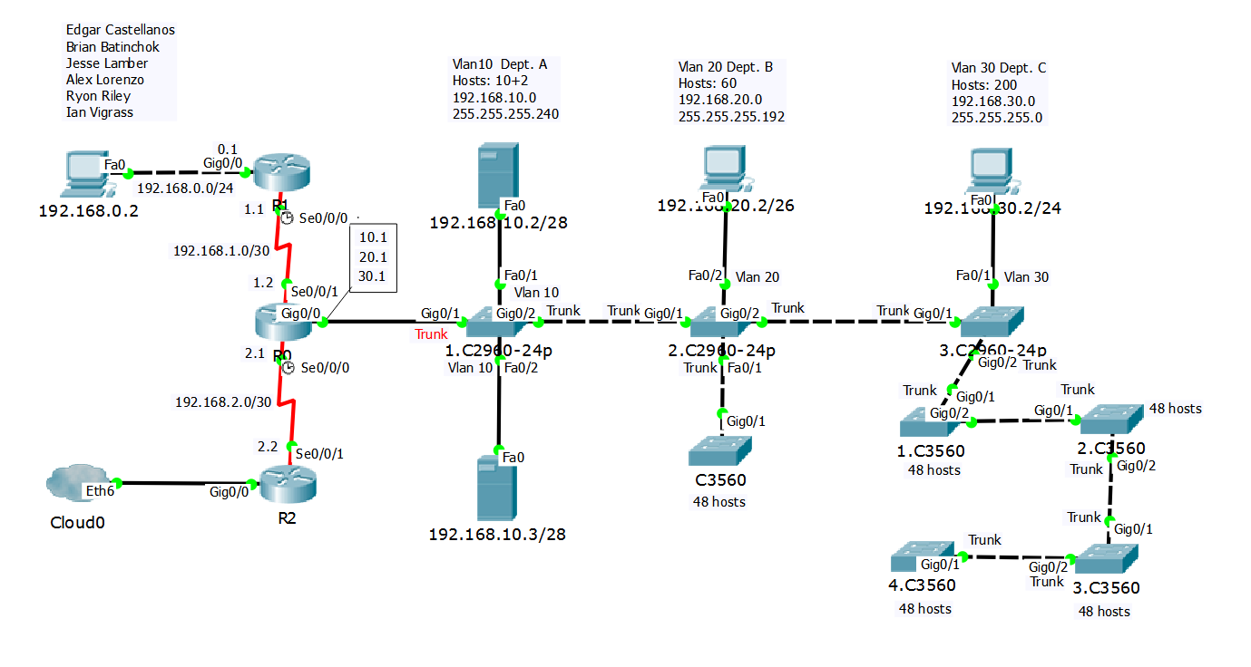
Our Topology

Slide 11
Sources
http://computer.howstuffworks.com/ethernet.htm
https://en.wikipedia.org/wiki/Serial_cable
https://en.wikipedia.org/wiki/Router_(computing)
http://whatis.techtarget.com/definition/server
https://en.wikipedia.org/wiki/Network_switch
http://searchnetworking.techtarget.com/definition/virtual-LAN
http://www.webopedia.com/quick_ref/topologies.asp

